Slide 1
IBM API Connect Overview

Slide 2
IBM API Connect Overview

Slide 3

APIC Capabilities
API Lifecycle Management Automated creation of new APIs in minutes.
Secure API’s Securely exposing enterprise services via APIs to new mobile, IoT, and web applications.
Visual Coding Options Automated, visual, and coding options that API providers can use to create scalable APIs
Built-In Policies Built-in policies like Gateway script , Javascript , Json to XML , XML to JSON , Generate JWT , Validate JWT , redaction policy etc
Developer Portals Customizable, self service portals for publishing APIs for discovery and use.
Analytics API usage analytics for both API providers and consumers, with runtime and historical reporting on usage patterns and performance metrics.
Monetization Set pricing details in plans to define revenue-producing subscription plans for your APIs

Slide 4
API Connect Capabilities
API Connect (APIC) is an API management solution that addresses critical aspects of the API lifecycle providing the capability to create, run, manage and secure APIs and microservices. It can be used to create high-quality, scalable and secure APIs for application servers, enterprise service buses (ESB), databases, and mainframes (z/OS Connect).
Lightweight design-time governance for API registration
Visibility
Runtime Integration
Manage consumer-provider relationships
Lifecycle Management
Discover APIs, even across lines of business, i.e. with a public and private API catalog
Additional Features
API Analytics
Support for any type of documentation (including OLAs, SLAs, and ICDs)
Administrators can manage security and governance over APIs
API Versioning
Runtime governance (rate limiting and quota management)
Developer Portal
Operations Automation

Slide 5
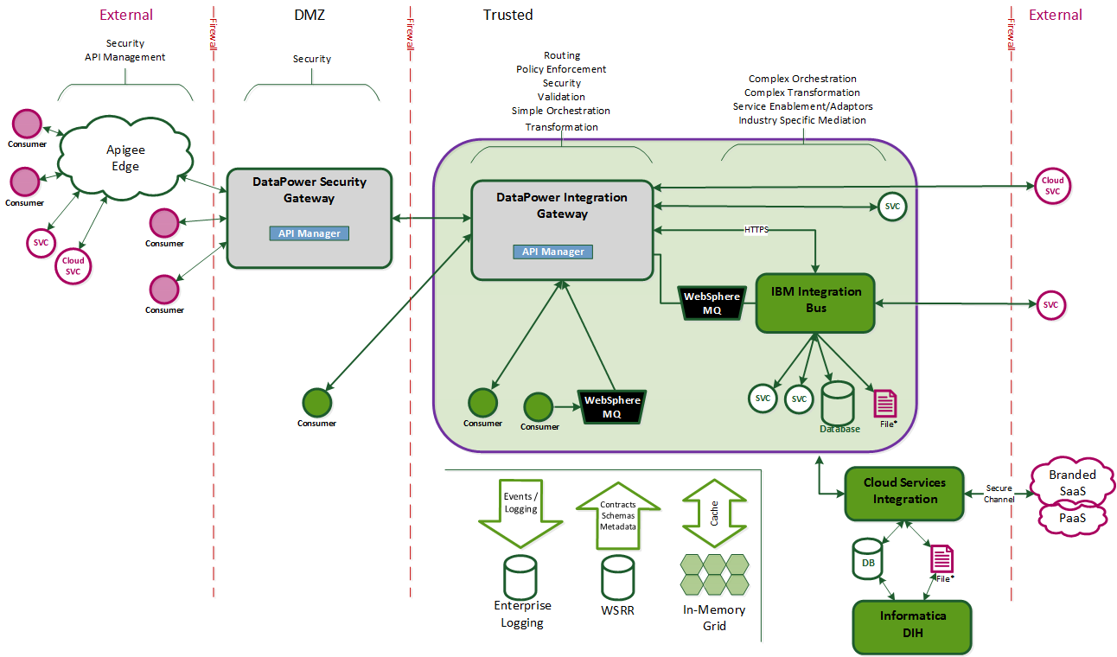
Where It Fits

Slide 6
When to use APIC
REST API’S:
All lightweight REST API’s which deal with <= 4MB * payloads . Basically real time transactions with the <=4MB limit can go through APIC ( if the interface deals with batch transfers, it needs to be built on Datapower).
Proxy to Datapower services :
Can be built as a proxy to existing/new Datapower services which deal with less than 4MB* payloads
When to use Datapower over APIC:
Payloads > 4MB:
All services which deal with > 4MB payloads
MQ Integration:
Services which need MQ integration
IIB Integration:
Services which need IIB integration
SLM
Services which need SLM shaping
* 4MB threshold used initially but may be increased during API Prove phase as we “test and learn” payload limits

